Slide 1
ESAs Doses and Side Effects
Hamid Tayebi Khosroshahi, MD

Slide 3
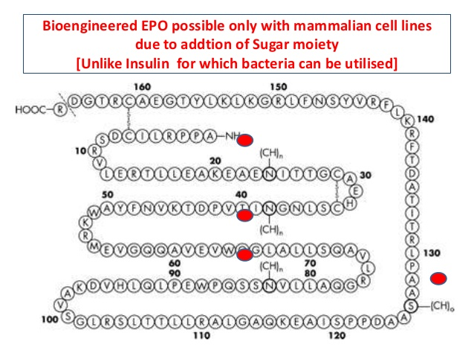

Slide 7
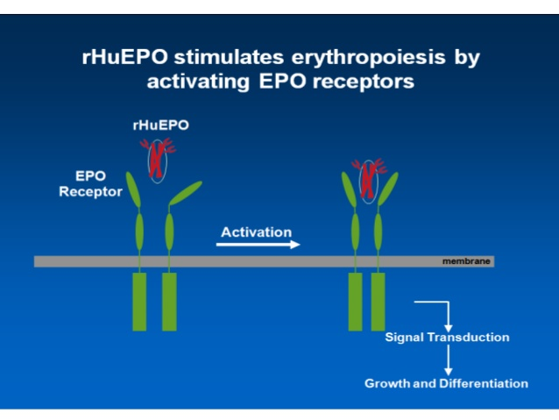

Slide 15
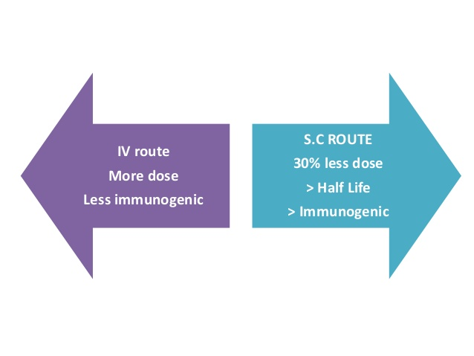

Slide 18
There are several safety issues with ESAs:
ESAs increase the risk of venous thromboembolism (blood clots in the veins).
ESAs can cause hemoglobin to rise too high, which puts the patient at higher risk for heart attack, stroke, heart failure, and death.
In patients who have cancer, ESAs may cause the tumor to grow. If ESAs are used for these patients, they are usually stopped after the patient's chemotherapy is finished.
The health care provider will keep an eye on the patient's blood cell counts to make sure they do not put him or her at a higher risk. The dosing may change, depending on the patient's needs.

Slide 19
Patients who have the following conditions need to consult with their health care provider if an ESA is being considered as part of the treatment plan:
Heart disease
High blood pressure
Porphyria (a group of diseases that are caused by enzyme deficiencies)
Seizures
An allergy to epoetin alfa or any other part of this medicine
In addition, women who are pregnant, planning to become pregnant, or breastfeeding should consult with their health care provider before taking an ESA.

Slide 20
INDICATIONS FOR TREATMENT OF ANEMIA
— Anemia should be treated. Among hemodialysis patients, untreated anemia is usually severe (typically with hemoglobin [Hb] 6 to 8 g/dL) and, if left untreated, associated with increased mortality and disabling symptoms.
The treatment of anemia includes erythropoiesis-stimulating agents (ESAs) and/or intravenous (IV) iron.
The goal of treatment is to mitigate any symptoms due to anemia and to reduce the likelihood of needing a blood transfusion. The selection of the individual therapy depends on the severity of anemia and on the presence of iron deficiency.

Slide 21
The indications for treatment are based upon US Food and Drug Administration (FDA)-issued guidelines for ESA administration, although these are occasionally modified in selected individuals. Our approach is consistent with the 2012 Kidney Disease: Threshold transferrin saturation (TSAT) and ferritin levels for initiating treatment with iron are different in patients who have an Hb concentration <10 g/dL OR are on an ESA versus those who have an Hb ≥10 g/dL (algorithm.

Slide 22
Low hemoglobin <10 g/dL and transferrin saturation (TSAT) ≤30 percent and ferritin ≤500 ng/mL — Such patients should be treated with IV iron. Although they are unlikely to be iron deficient as defined by bone marrow biopsy, the administration of iron may still increase the Hb.
Such patients may also require an ESA, but a loading dose of iron should be given first with repeat assessment of Hb prior to starting the ESA.
Patients who develop iron deficiency according to these criteria while on an ESA are also treated with IV iron.

Slide 23
Hemoglobin ≥10 g/dL and TSAT ≤20 percent and ferritin ≤200 ng/mL — Such patients are likely iron deficient and should be treated with IV iron.
Hemoglobin ≥10 g/dL and TSAT >20 percent and ferritin >200 ng/mL — Such patients are not treated with iron and continue to be monitored closely.
Although patients may be considered anemic by World Health Organization (WHO) standards, they do not meet criteria for ESA therapy.

Slide 24
Low hemoglobin <10 g/dL and TSAT >30 percent
— Such patients are usually started on an ESA,
ESAs have been associated with an increased risk of stroke and death due to malignancy.

Slide 25
TREATMENT, Erythropoiesis-stimulating agents
Indications and contraindications — We administer erythropoiesis-stimulating agents (ESAs) to most hemodialysis patients who have a hemoglobin (Hb) <10 g/dL and are not iron deficient (or no longer iron deficient).
ESAs are effective in treating anemia. Among hemodialysis patients with severe anemia, ESAs reduce the need for transfusion [8,9] and improve quality-of-life symptoms, exercise tolerance, and left ventricular hypertrophy, which has been associated with mortality [10-15].

Slide 26
Important exceptions are patients with malignancy, particularly those in whom cure is anticipated or who have had a stroke, since such patients may be at higher risk for adverse effects from ESAs [7].
The treatment of such patients should be individualized after careful consideration and discussion of the possible risks and benefits of ESA therapy.
The optimal target Hb for ESA dosing is not known.

Slide 27
Dosing — In most patients, we initiate treatment with epoetin at approximately 50 units/kg three times per week. This is a relatively low starting dose; among patients with severe or symptomatic anemia, we may use a higher starting dose of 100 units/kg three times per week.
The US Food and Drug Administration (FDA)-recommended starting dose is 50 to 100 units/kg three times per week for both intravenous (IV) and subcutaneous administration.

Slide 28
Other ESAs used for treatment of anemia in hemodialysis patients include darbepoetin, with US FDA-recommended starting doses of 0.45 mcg/kg every week or 0.75 mcg/kg every two weeks,
We titrate the dose upwards as necessary to achieve the target Hb level. The dose of ESA required to reach target Hb varies widely among hemodialysis patients .Generally, the dose is adjusted monthly in response to the Hb.

Slide 29
The Hb increase should generally be in the range of 1 to 2 g/dL per month. The dose of ESA should be reduced in patients whose Hb rises above this threshold increase. Among those with an Hb increase greater than 2.5 to 3 g/dL per month, the ESA dose should be held or reduced by at least 50 percent. While some clinicians reduce the ESA dose (as is recommended in the KDIGO anemia guidelines [7]), holding the ESA completely may reduce the number of times that the Hb exceeds target and decrease the ESA used per dialysis session.

Slide 30
Route of administration
Either IV or subcutaneous ESA administration may be used. Several studies have shown that the subcutaneous dose of ESA required to achieve a target Hb is approximately 30 percent less than that required with IV administration.
This was best shown in one of the largest prospective studies, in which 208 hemodialysis patients were randomly assigned to either subcutaneous or IV epoetin. At 26 weeks, the average subcutaneous epoetin to achieve target Hb levels was lower than the IV dose (95 versus 140 units/kg per week). This is an important consideration since higher ESA doses (independent of Hb) may be associated with worse cardiovascular outcomes.

Slide 31
A retrospective study of over 62,000 hemodialysis patients confirmed that equivalent Hb levels were obtained with 25 percent less epoetin administered subcutaneously compared with IV administration but also found that the composite adverse event outcomes of death and/or hospitalization for cardiovascular complications (heart failure, acute myocardial infarction, or stroke) were more common in IV epoetin-treated patients, perhaps due to the higher epoetin dose [25].

Slide 32
However, IV administration is often favored for hemodialysis patients because subcutaneous administration is associated with significantly greater discomfort and IV access is available for the dialysis treatment. In the United States, over 90 percent of hemodialysis patients received ESAs intravenously in a report published in 2004 [26]. Subcutaneous administration used to be more commonly used outside the United States. However, a reduction in use of subcutaneous ESAs followed an outbreak of pure red cell aplasia attributed to subcutaneous use of a particular ESA formulation that was not available in the US [27-30]. In the report cited above, IV administration was the major route in 11 of 12 countries [26].

Slide 33
EPO ALFA, BETA, OMEGA AND DELTA
Endogenous erythropoietin (EPO) consists of a central polypeptide core covered by post-translationally linked carbohydrates.
Three of the four currently available erythropoiesis stimulating agents (ESA)--epoetin-alpha, epoetin-beta and epoetin-omega- are composed of an identical amino acid sequence, but glycosylation varies as a result of type- and host cell-specific differences in the production process.
Epoetin-alpha and epoetin-beta resemble each other with respect to molecular characteristics and pharmacokinetic data, although epoetin-beta has a higher molecular weight, a lower number of sialylated glycan residues and possibly slight pharmacokinetic advantages such as a longer terminal elimination half-life.
A serious adverse effect of long-term administration of ESA is pure red cell aplasia. This effect has been observed predominantly with subcutaneous use of epoetin-alpha produced outside the US after albumin was removed from the formulation.

Slide 34
In comparison with the intravenous route, subcutaneous administration of epoetin has been reported to have a dose-sparing effect in some studies. Epoetin-beta has been the subject of studies aimed at proving efficacy with a reduced administration frequency but results are not unequivocal. Epoetin-omega is produced in a different host cell than all other erythropoietic agents, hence glycosylation and pharmacokinetics are different. Small-scale clinical studies found epoetin-omega to be slightly more potent than epoetin-alpha..

Slide 35
Epoetin-delta is a recently approved agent produced by human cells that are genetically engineered to transcribe and translate the EPO gene under the control of a newly introduced regulatory DNA sequence. However, epoetin-delta is not yet on the market and few data are available. The erythropoietin analogue darbepoetin-alpha carries two additional glycosylation sites that permit a higher degree of glycosylation

Slide 36
Among several types of ESAs, epoetin alfa and beta, 2 short-acting ESAs, have shown the same efficacy in treating CKD-induced anemia. Some studies suggest that subcutaneous (SC) injection of epoetin beta is less painful than epoetin alfa [5, 6]. Other studies have demonstrated that elimination half-life of epoetin beta is longer than epoetin alfa, which is probably due to different glycosylation. As a result, lower doses may be needed to maintain hemoglobin and hematocrit in the target level [7–9]. However, the Kidney Disease Improving Global Outcomes (KDIGO) guideline along with other evidence suggest that epoetin alfa and beta have the same efficacy and require the same dose to be administered to patients with CKD-induced anemia [10, 11].

Slide 37
Target Hb levels
— Although ESAs have been shown to provide benefit compared with no ESAs, the optimal target Hb level for hemodialysis patients is not well defined. In most dialysis patients who are treated with ESAs, we maintain levels between 10 and 11.5 g/dL.
We individualize therapy in some patients who may have improvements in quality of life at Hb ≥11.5 g/dL and will be prepared to accept the risks associated with higher Hb targets.
We do not target an Hb concentration >13 g/dL.
The lowest ESA dose necessary to achieve a desired Hb level should be used, and excessively high doses in patients with ESA hyporesponsiveness should be avoided. Limited evidence suggests that an increased mortality may be due to high ESA doses.

Slide 38
In clinical practice, it is difficult to maintain individual patient Hb values within any narrow range. While we try to maintain Hb levels between 10 to 11.5 g/dL in most patients, Hb levels >11.5 g/dL will occur transiently in many patients due to a variety of factors and should prompt appropriate gradual dose reductions in the ESA being used.
Such transient elevations of Hb >11.5 g/dL are not likely to be associated with important clinical consequences, although some (but not all) studies have reported an association between greater degrees of Hb variability and adverse clinical outcomes [35].

Slide 39
The US FDA boxed warning on ESAs states that, for patients on dialysis, one should initiate ESA treatment when the Hb level is <10 g/dL and reduce or interrupt the ESA dose if the Hb level approaches or exceeds 11 g/dL. Our recommendations are largely consistent with the KDIGO 2012 guidelines .

Slide 40
Among all chronic kidney disease (CKD) patients (ie, dialysis and nondialysis), multiple studies have shown that Hb targets >13 g/dL are associated with adverse outcomes.
The best data among hemodialysis patients are from the Normal Hematocrit Trial (NHT), in which 1233 hemodialysis patients with cardiac disease, defined as heart failure or ischemic heart disease, and baseline Hb values of 9 to 11 g/dL on an ESA were randomly assigned to achieve and maintain an Hb of either 14 or 10 g/dL [8].

Slide 41
The study was terminated after 29 months after concerns about safety were raised by an independent data monitoring committee. The group targeted to Hb 14 g/dL (ie, normal Hb) had a higher risk of the combined endpoint of death or nonfatal myocardial infarction (MI; relative risk [RR] 1.3, 95% CI 0.9-1.9). After 29 months, there were 183 deaths and 19 nonfatal MIs in the 14 g/dL group versus 150 and 14, respectively, in the 10 g/dL group.

Slide 42
The one- and two-year mortality rates were 7 percent higher in the 14 g/dL group than in the 10 g/dL group. In addition, the risk of thrombosis of grafts and fistulae in the 14 g/dL group was higher than in the 10 g/dL group. No differences were initially reported between the groups for all-cause hospitalization or other endpoints such as nonfatal MI or stroke [8]. However, according to the trial report submitted to the US FDA, the higher hematocrit group had a higher rate of hospitalization, although the difference was of marginal statistical significance (RR 1.14, 95% CI 0.99-1.30) [44].

Slide 43
In addition to these data, which were limited to hemodialysis patients, a number of meta-analyses and systematic reviews have been performed, mostly including nondialysis CKD patients. Although limited by heterogeneity, most suggest that targeting higher Hb levels with ESAs does not lower mortality and increases cardiovascular risk and the risk of malignancy.

Slide 44
ESAs may also not improve health-related quality of life among dialysis patients when comparing Hb levels of approximately 9 to 10 g/dL to higher levels.
Perhaps the best data are from a meta-analysis including 17 randomized trials that specifically reported on changes in health-related quality of life using validated instruments including the Short Form (SF)-36 (13 studies) and the Kidney Disease Questionnaire (KDQ; four studies) [45].

Slide 45
The SF-36 reports on eight domains including physical function, physical role, bodily pain, general health, vitality, emotional role, social function, and mental health. The KDQ reports on fatigue, depression, relationships with others, frustration, and physical symptoms.
The achieved Hb was 7.4 to 12 g/dL in the placebo-treated and/or lower Hb target group and 10.2 to 13.6 g/dL in the higher Hb target group.

Slide 46
While in some of the individual published studies there were statistically significant improvements in one or more of the SF-36 physical function scores, in the meta-analysis, there were no significant differences between groups in any SF-36 or KDQ domains when comparing Hb levels of 9 to 12 g/dL compared with Hb levels >11 g/dL.
Some quality-of-life measures do improve in some patients as Hb levels are raised from lower levels up to approximately 11 g/dL. Among studies that reported SF-36 results, there was a statistically nonsignificant trend toward improvement in physical function in the nondialysis CKD subgroup but not in the dialysis subgroup.

Slide 47
However, confidence in the meta-analysis is somewhat limited by the high risk of bias in most of the studies and by the considerable heterogeneity in study population, design, and achieved Hb concentrations.
It is possible that selected individuals, particularly younger, active patients who have severe anemia but few other comorbidities, may benefit from maintaining the Hb above the 10 to 12 g/dL target with respect to quality of life.

Slide 48
Adverse effects of erythropoiesis-stimulating agents
—
Some adverse effects have only been described when ESAs are used to attain a normal Hb. As noted above, these include increased mortality, cardiovascular events, and malignancy .
There is also an increased risk of hemodialysis access thrombosis when ESAs are used to maintain normal or near-normal Hb .
In the NHT trial, access thrombosis occurred in 39 percent in the 14 g/dL group compared with 29 percent in the 10 g/dL group [46].

Slide 49
Hypertension may be observed when ESAs are used to target lower Hb concentrations . The risk of hypertension appears to be independent of the target Hb.
A rapid rise in blood pressure may cause hypertensive encephalopathy accompanied by seizures, although we believe that this is uncommon today. Although the reported incidence ranges from 2 to 17 percent, most studies that have reported on seizure incidence are from the early 1990s, when ESA doses and Hb targets were higher than are typically used today.
A 2004 meta-analysis showed no increase in the incidence of seizures among patients treated with an ESA compared with those not treated with an ESA; however, included studies were of both predialysis and dialysis CKD patients, which may have resulted in an underestimate of incidence among dialysis patients.

Slide 50
There is little evidence of increased incidence of seizures in normotensive patients treated with an ESA.
It is not possible to predict in advance who will develop seizures with an ESA. Prodromal symptoms including persistent headache or visual disturbances that develop in the early weeks after institution of an ESA suggest the possibility that seizures will occur. The presence of other ESA-related reactions or side effects (such as exacerbated hypertension or a rapid rise in Hb) may suggest the possibility of seizures.

Slide 51
TRANSFUSION — Red blood cell (RBC) transfusions will immediately raise hemoglobin (Hb) levels. However, they may be associated with significant complications that include transfusion-transmitted infection (very rare), immunologic sensitization, iron overload syndromes, volume overload, and/or transfusion reactions. Transfusions are rarely administered in chronic dialysis facilities but are indicated for treatment of severe or symptomatic chronic anemia unresponsive to erythropoiesis-stimulating agent (ESA) and iron therapy.

Slide 52
The End , Thank You

